Slide 1

APPLICATION LAYER DISTRIBUTED DENIAL OF SERVICES ATTACK DETECTION USING DEEP LEARNING MODELS
COMPSCI 790: Introduction to CyberSecurity
Team:
Akash Reddy Jammula
Chaitanya Swarna

Slide 2

Outline
Introduction
Problem Statement
Existing Solution
Dataset
Implementation
Results
Conclusion
References

Slide 3

Introduction
Distributed Denial of Service attacks are major threats to networks, including IoT, cloud, and 5G, aiming to disrupt services by flooding them with malicious traffic.
Our project focuses on using deep learning models to combat the pervasive threats of DDoS attacks

Slide 4
Problem Statement
Our project addresses the gap in cybersecurity by targeting slow-rate DDoS attacks at the application layer. Using advanced deep learning models like LSTM and CNN, we aim to detect and mitigate these evasive threats. Despite challenges like limited datasets and subtle attack patterns, our innovative approach integrates cutting-edge technologies to develop robust detection mechanisms.

Slide 5

Existing Solutions
Solutions using Long Short-Term Memory (LSTM) and fuzzy logic have been developed for detection and mitigation in SDN environments, showing high accuracy but focusing only on high-volume attacks.
Combining supervised and unsupervised ML techniques has been proposed for detecting DDoS attacks, but these did not use current datasets and were limited in the range of methods and attack types explored.

Slide 6

Dataset
CICIDS-2017 (Canadian Institute for Cybersecurity Intrusion Detection Systems Evaluation Dataset 2017) is a publicly available dataset created for evaluating intrusion detection systems (IDSs).
This dataset comprises 79 features that provide information about various aspects of network traffic. Some of the features are Source IP address, Destination IP address, Source port, Destination port, Packet_size.

Slide 7

Implementation
Models used:
LSTM: Long Short-Term Memory networks are well-suited for processing and learning from sequential data, making them ideal for analyzing network traffic patterns.
CNN: Convolutional Neural Network models excel at detecting spatial patterns in data, making them suitable for identifying spatial features in network traffic.

Slide 8
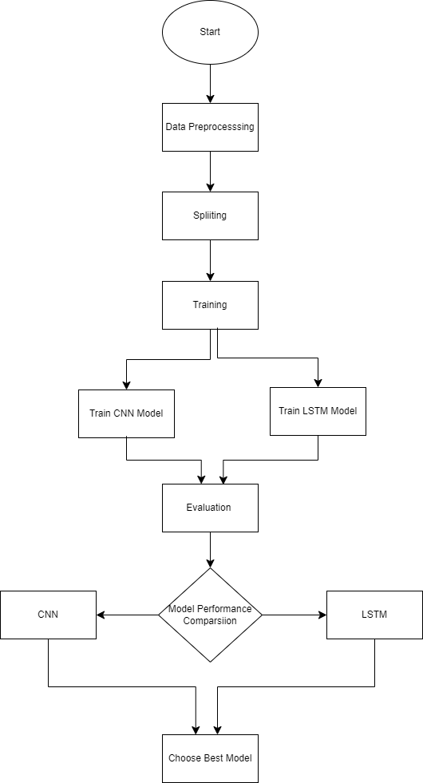
Flow Chart

Slide 9
Data preprocessing: In the preprocessing phase, several steps are undertaken to prepare the data for model training.
Training: Two deep learning architectures, Convolutional Neural Network (CNN) and Long Short-Term Memory (LSTM), are designed and trained using the preprocessed data.
Model Evaluation: Their performance is assessed using relevant evaluation metrics such as accuracy, precision, recall, and F1-score.
Model Comparison: Based on the evaluation results, the model with superior performance is selected
Implementation

Slide 10
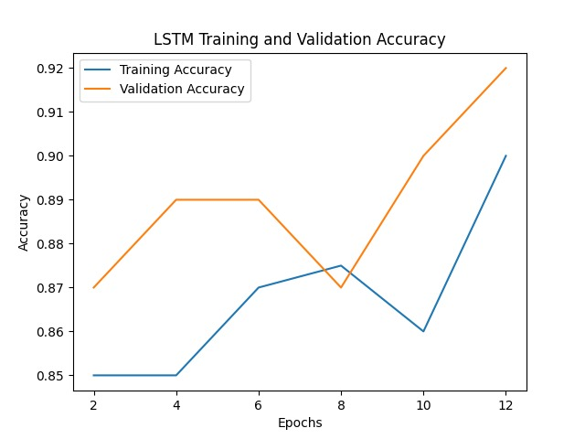
Results
For LSTM:

Slide 11
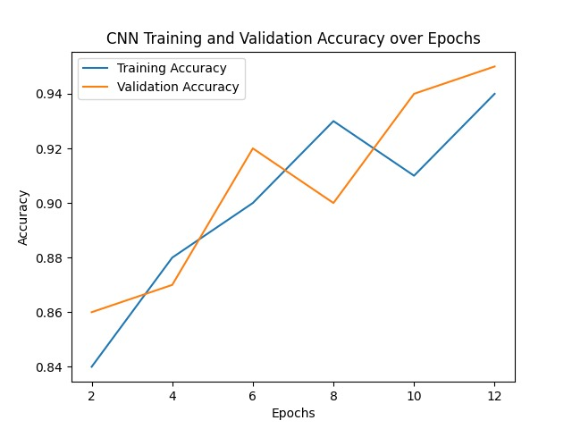
Results
For CNN:

Slide 12
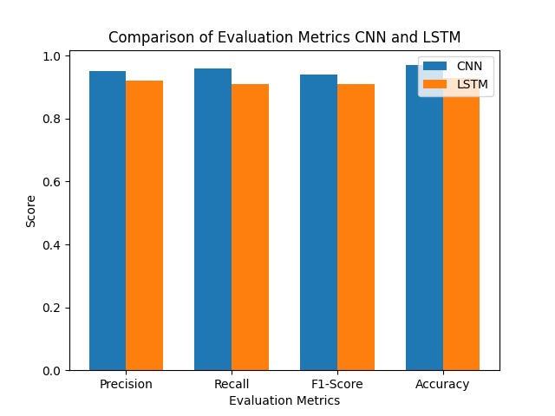
Comparison of Evaluation metrics

Slide 13
Conclusion
LSTM and CNN models demonstrated promising results in detecting application layer DDoS attacks.
Both models exhibited high accuracy and effectiveness in distinguishing between benign and malicious traffic.
Training and validation curves showed stable convergence, indicating robust learning capabilities.

Slide 14
References
Research paper: IEEE Xplore Full-Text PDF:
Dataset: https://www.kaggle.com/code/kooaslansefat/cicids2017-safeml/input
https://ieeexplore.ieee.org/stamp/stamp.jsp?tp=&arnumber=9502698
https://hal.science/hal-04262657/document

Slide 15
Thank You!

